Slide 1
H R Analytics
Course Introduction

Slide 2
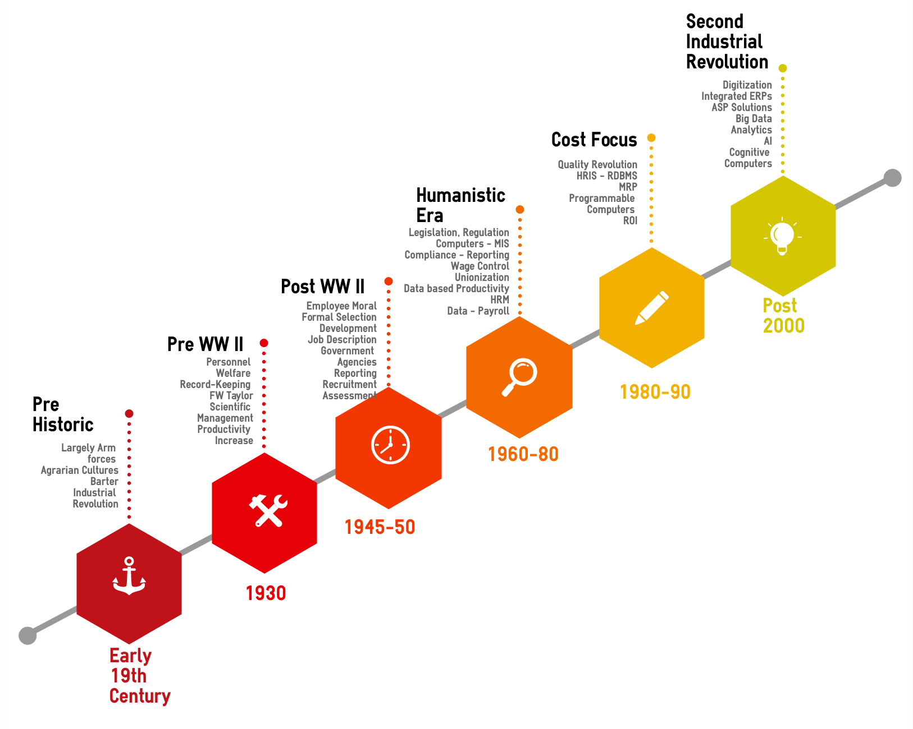
Evolution in HR Data Application

Slide 3
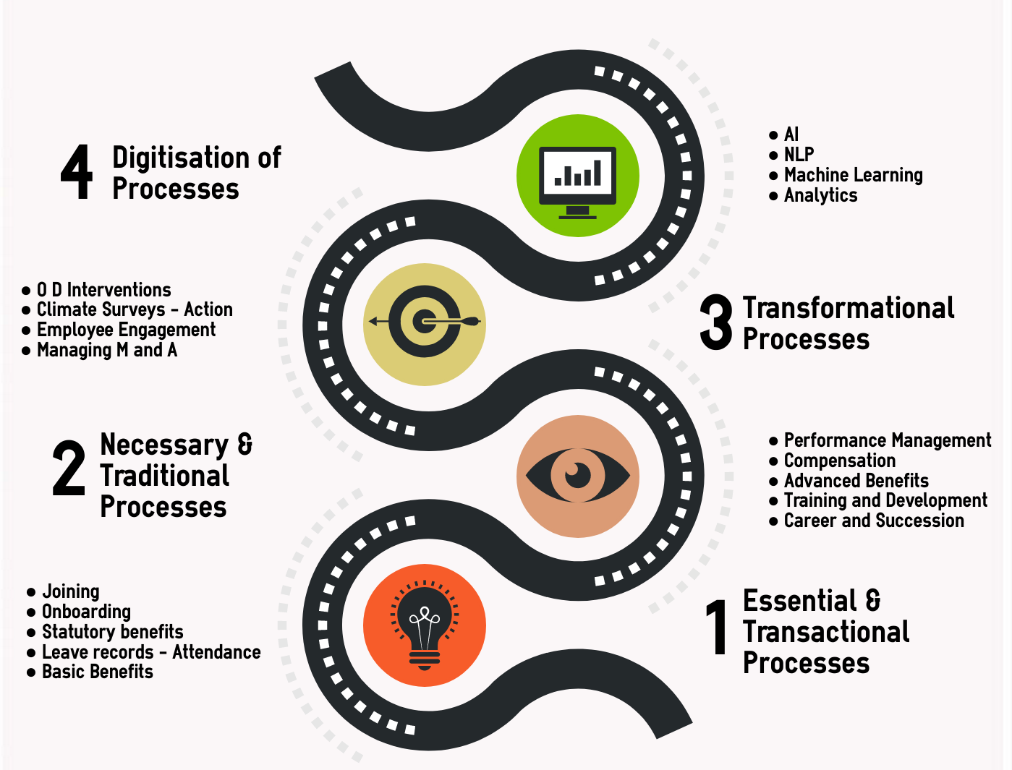
Evolution in HR Processes

Slide 4
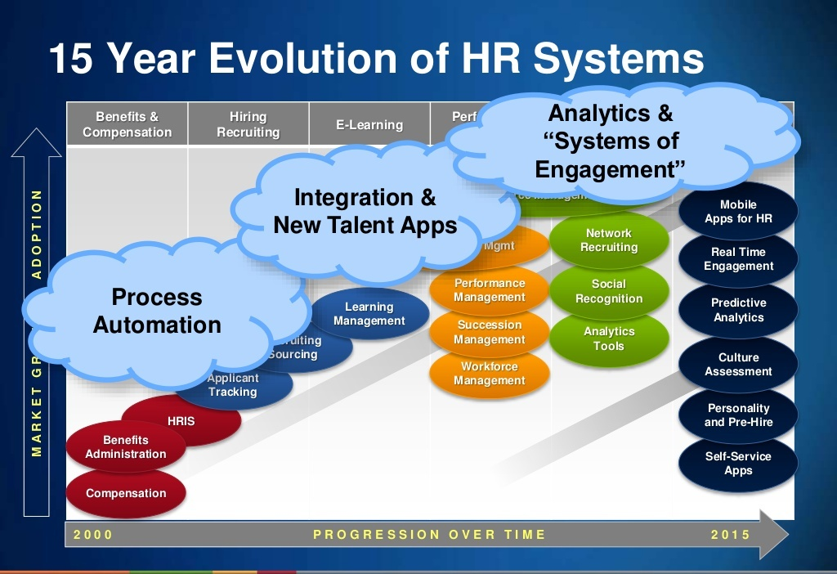

Slide 5
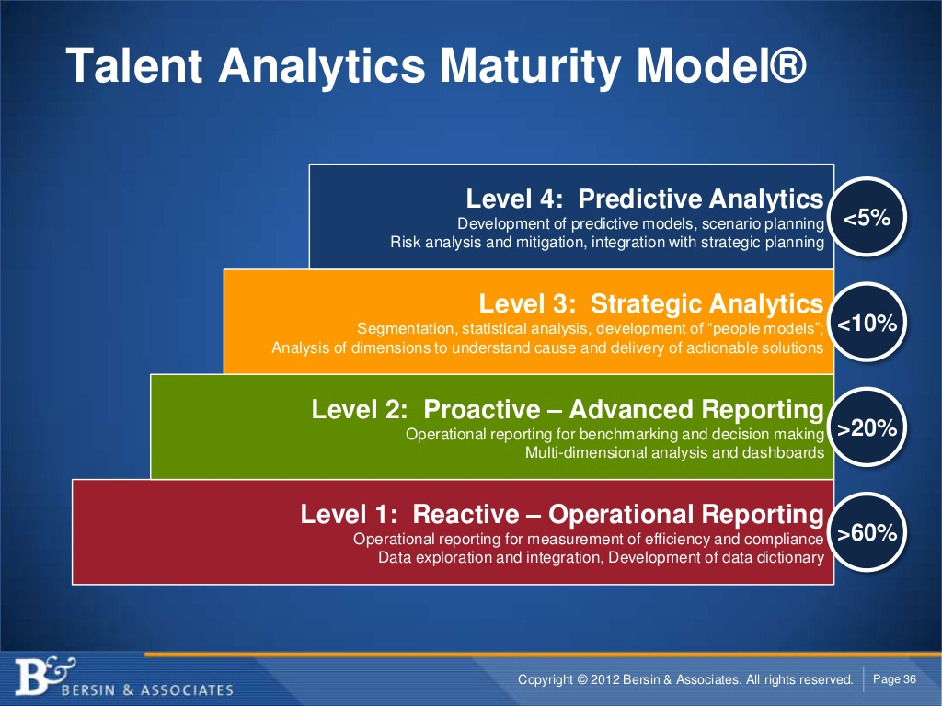

Slide 6
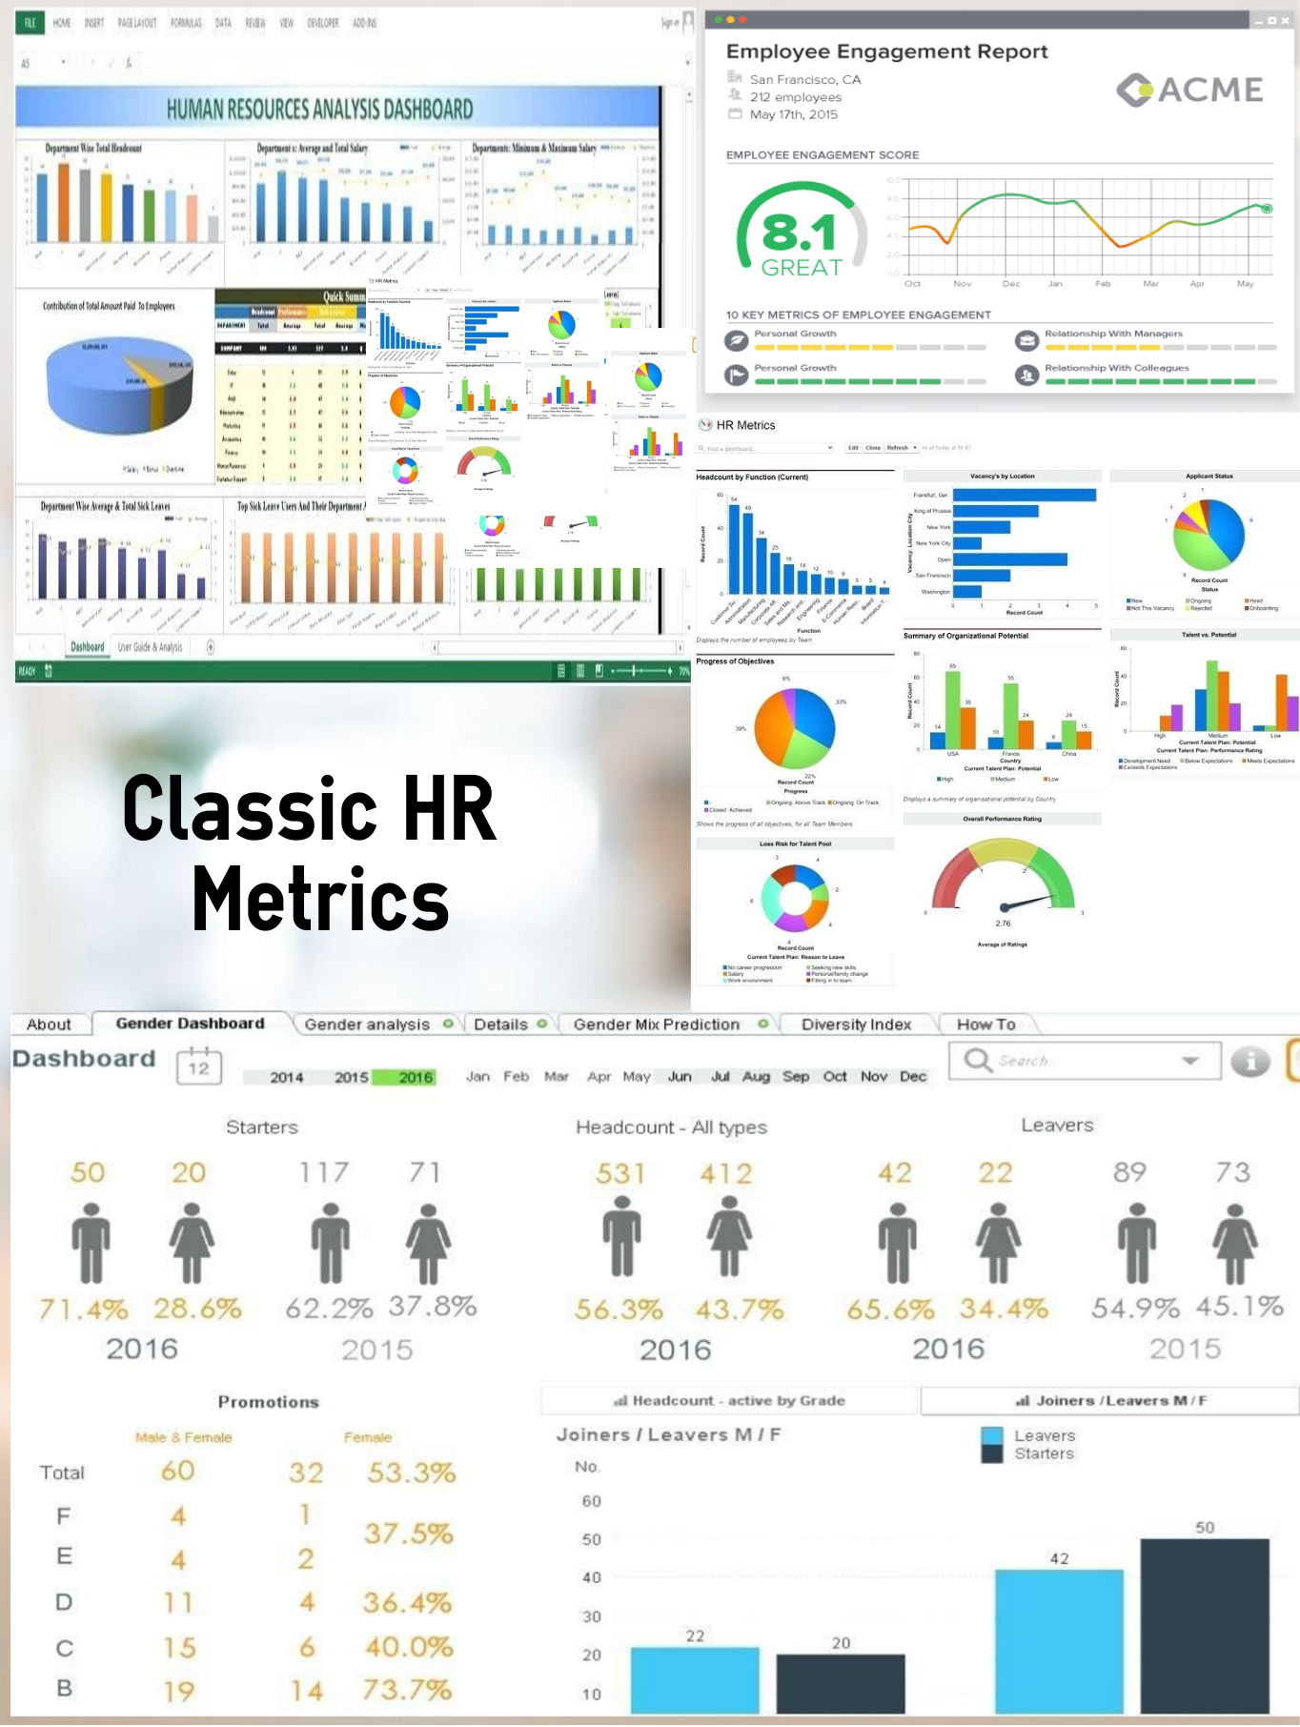

Slide 7
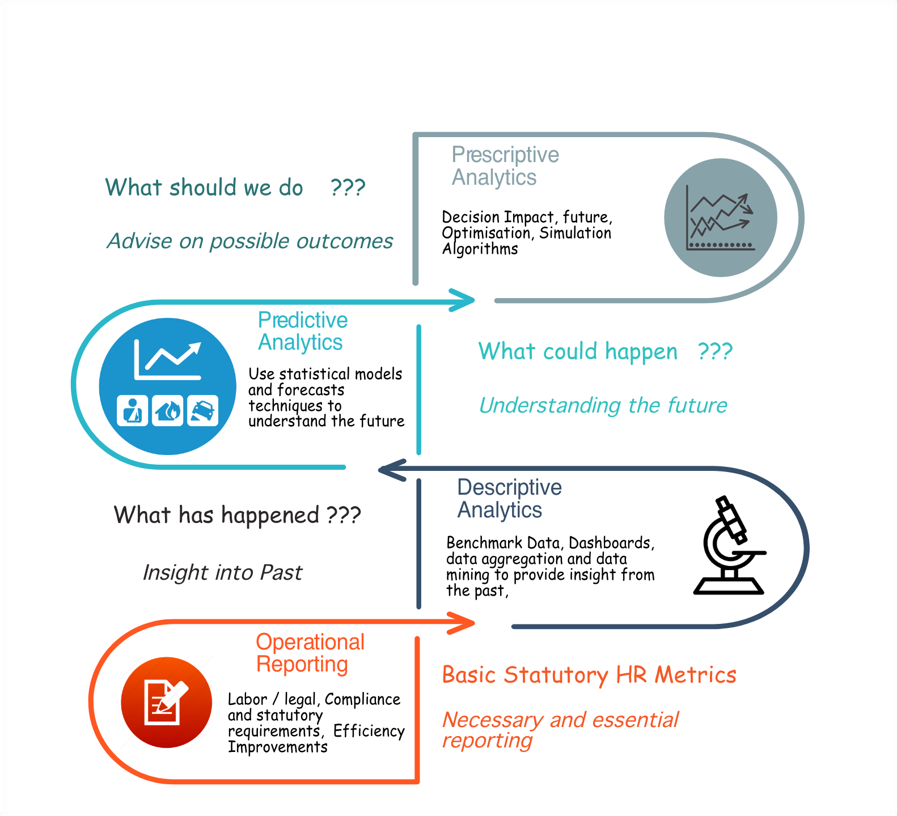

Slide 8


Slide 9
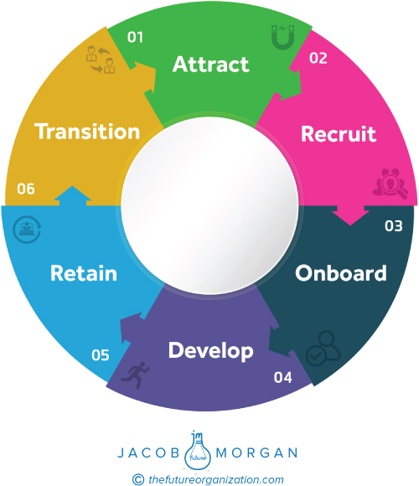
Employee Life Cycle

Slide 10
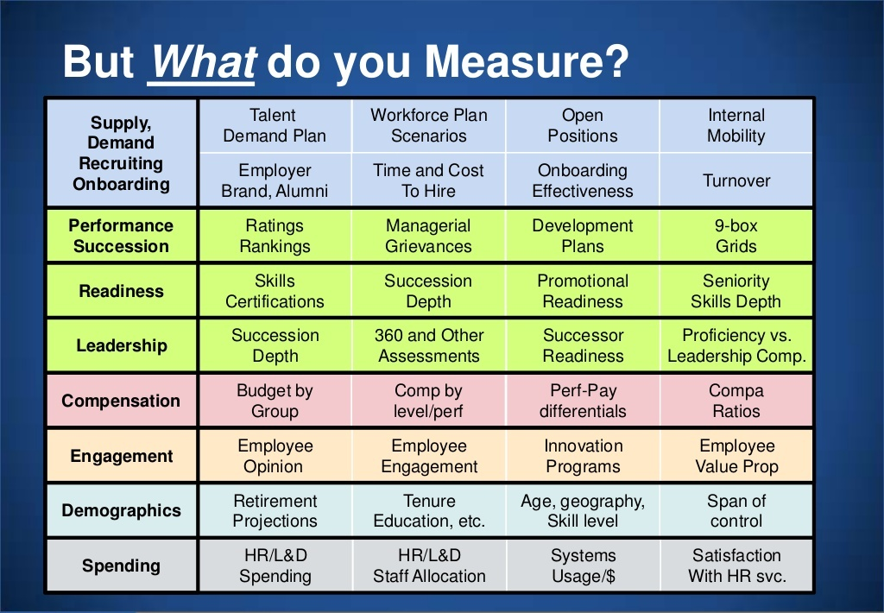

Slide 11
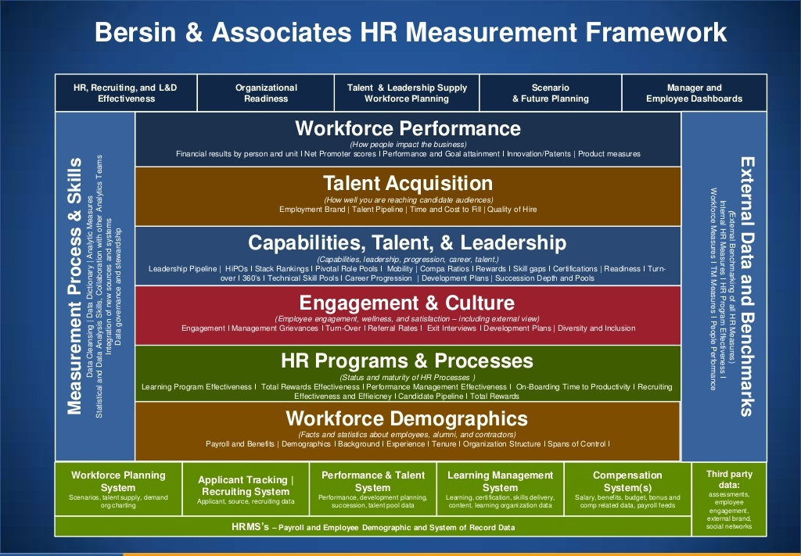

Slide 12
H R Analytics
Snapshots

Slide 13
H R Analytics
Talent Acquisition
Employer Branding
Portal Performance
Funnel Management
Cost of Acquisition
Quality of hires
Speed
Tech Intervention
Pre-boarding
On-boarding
Innovative approaches – Hackathon etc
Dependent Variables
Cost
Quality ( ratings, Scores etc.)
Retention
Tools
Logistic Regression
SEM
Survival Analysis

Slide 14
H R Analytics
Employee Engagement
Process
Tools
Engagement levers
Retention
Productivity
OD Interventions planning
Different cuts across Categorical variables
Psychometrics
Dependent Variables
Quality ( ratings, Scores etc.)
Retention
Productivity
Tools
Factor Analysis
Random Forest
Regression ( Ridge, Lasso)
Panel Analysis
Text Mining
CART

Slide 15
H R Analytics
Training and Development
Training Interventions ( Content)
Type of Interventions
Cost
Performance
Retention
Leadership pipeline
Dependent Variables
Training Effectiveness
Training cost and ROI
Quality ( ratings, Scores etc.)
Retention
Tools
Regression
Text Mining
Regression
Panel Analysis

Slide 16
H R Analytics
Compensation and Benefits
Benchmarking
Compa ratios
Budget utilisation and allocation
Cost effectiveness of Benefits
Dependent Variables
Retention – performers
Budget
Cost of Benefits
Tools
Regression
Panel Analysis
Scatter Plots
Cluster Analysis

Slide 17
H R Analytics
Performance and Potential Management
Training Interventions ( Content)
Type of Interventions
Cost
Performance
Retention
Leadership pipeline
Dependent Variables
Performance Ratings
Potential Scores
Retention of performers
Tools
Regression
Text Mining
Panel Analysis

Slide 18
H R Analytics
Retention Management
Quality of Hires
Employee Engagement
Culture
Leaders
OD interventions
Compensation parity
Retention
Dependent Variables
Retention rate
Retention of performers
Tools
Regression
Text Mining
Survival Analysis

Slide 19
Data Types
Variables
Scale
(Measurement of Counts)
Nominal
( No meaningful Order – Gender, Location)
Ordinal
(Obvious Order Likert Scale performance )
Categorical
( Tick box on Questionnaire)
Discrete
( No. Of children)
Continuous
( Takes any value)

Slide 20
Summary Stats
Which average measure of Spread
Scale
(Measurement of Counts)
Nominal
( Mode)
Ordinal
(Median , Interquartile range)
Categorical
( Tick box on Questionnaire)
Skewed Data
(Median , Interquartile range)
Normally Distributed
(Mean, Std Deviation)

Slide 21
Appropriate Methods
Dependant
Scale
(Measurement of Counts)
Nominal
( Chi-Squared)
Ordinal
(Non Parametric)
Categorical
( Tick box on Questionnaire)
Skewed Data
(Non-Parametric)
Normally Distributed
(Parametric)

Slide 22
Common Single Comparison Tests
Comparing | Dependant (Outcome Variable) | Independent ( Explanatory Variable) | Parametric Test ( Data is normally Distributed) | Non-Parametric Test (Ordinal / Skewed Data)
The Averages of two INDEPENDANT groups | Scale | Nominal ( Binary) | Independent ‘t’ test | Mann-Whitney test/ Wilcoxon rank sum
The Averages of 3+ independent groups | Scale | Nominal | One Way ANOVA | Kruskal Wallis Test
The average difference between paired (matched) samples e.g. weight before and after a diet | Scale | Time/ Condition variable | Paired t-test | Wilcoxon rank Test
The 3+ measurements on the same subject | Scale | Time/ condition variable | Repeated measures ANOVA | Friedman Test

Slide 23
Tests of association
Comparing | Dependant (Outcome Variable) | Independent ( Explanatory Variable) | Parametric Test ( Data is normally Distributed) | Non-Parametric Test (Ordinal / Skewed Data)
Relationship between 2 continuous variables | Scale | Scale | Pearson’s Correlation Coefficient | Spearman’s Correlation Coefficient
Predicting the value of one variable from the value of a predictor variable or looking for significant relationships | Scale | Any | Simple Linear Regression | Transform The data
 | Nominal | Any | Logistic Regression
Assessing the relationship between two categorical variables | Categorical | Categorical |  | Chi-Squared Test

Slide 24
One scale dependent and several independent variables
1st independent | 2nd independent | Test
Scale | Scale / Binary | Multiple Regression
Nominal (Independent Groups) | Nominal (Independent Groups) | 2 Way ANOVA
Nominal ( repeated measures) | Nominal ( repeated measures) | 2 way repeated measures ANOVA
Nominal (Independent Groups) | Nominal ( repeated measures) | Mixed ANOVA
Nominal | Scale | ANCOVA

Slide 25
Common Single Comparison Tests
Comparing | Dependant (Outcome Variable) | Independent ( Explanatory Variable) | Parametric Test ( Data is normally Distributed) | Non-Parametric Test (Ordinal / Skewed Data)
The Averages of two INDEPENDANT groups | Scale | Nominal ( Binary) | Independent ‘t’ test | Mann-Whitney test/ Wilcoxon rank sum
The Averages of 3+ independent groups | Scale | Nominal | One Way ANOVA | Kruskal Wallis Test
The average difference between paired (matched) samples e.g. weight before and after a diet | Scale | Time/ Condition variable | Paired t-test | Wilcoxon rank Test
The 3+ measurements on the same subject | Scale | Time/ condition variable | Repeated measures ANOVA | Friedman Test

